Slide 2
Cal Poly Aerospace Engineering
Getting to know

Slide 3

Learn-by-doing; practicing and innovating Aerospace Design
Vision - An alumni base leading and innovating the Aerospace Industry
Mission - As faculty, students and staff, we collaborate with the Aerospace Industry to build partnerships which promote excellence and innovation to serve diverse communities. We work as a team to provide an excellent Learn-by-Doing, systems and design focused engineering education; graduating Day One-ready professionals
Innovate
Learn
Do

Slide 4
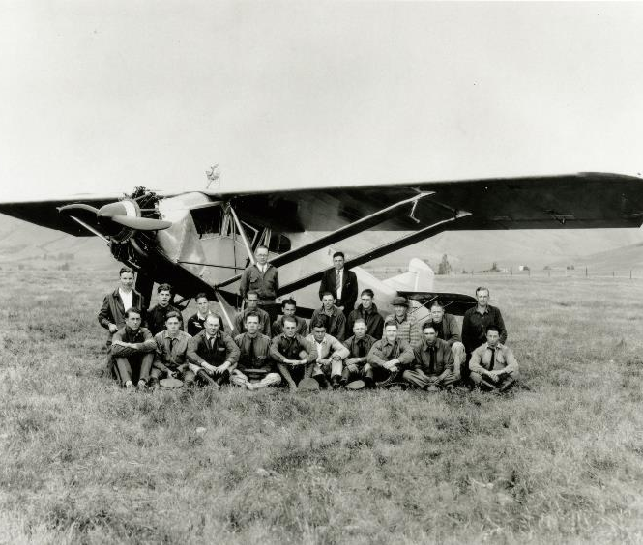
A bit of history
Founded in 1927 with an emphasis on Aircraft Mechanics and Maintenance
Started building airplanes in 1928
A strong tradition of Aerospace Systems Engineering and Design has been built as part of our “Learn-by-doing” motto
Incoming Freshman:
4.03 GPA
1305 SAT
Faculty and students with the first plane built at Cal Poly SLO. The design is based on the Spirit of St. Louis

Slide 5
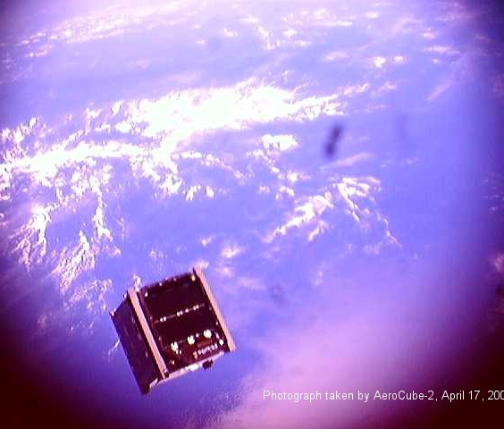
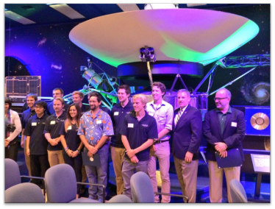
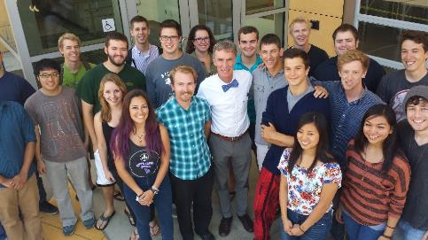
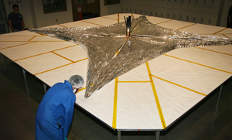
The home of Cubesat
CubeSat standard invented by Dr. Bob Twiggs of Stanford and Dr. Jorid Puig-Suari of Cal Poly
The CubeSat standard in currently maintained by students and faculty at Cal Poly
cubesat.org
Photograph of CP-4 taken by AeroCube, April 17th, 2007

Slide 6
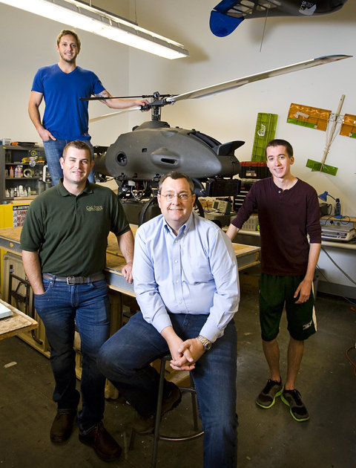
The future of uas
Applications of Autonomous Flight Initiative
Newly hired faculty member with 15+ years industry experience
Support for alumni and Cal Poly
Partnering with College of Agriculture
Goals
1. Prepare students to work in the UAS industry
2. Facilitate multi-disciplinary research using UAS
3. Research technologies for UAS
4. System assessment of UAS concepts
Dr. Aaron Drake, his team of students and the RMAX

Slide 7
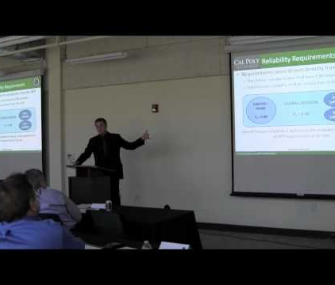
Senior design at Cal Poly
RFP and Requirements Driven
A strong emphasis on systems engineering principles
Industry-centric
Design projects are relevant industry projects
Industry sight visits and tours
Critical Reviews
3-4 industry hosted design reviews
Design Symposium hosted on campus in May – PDR/CDR level review
Students and Industry Representatives at the Cal Poly SLO Aircraft and Spacecraft Design Symposium

Slide 8
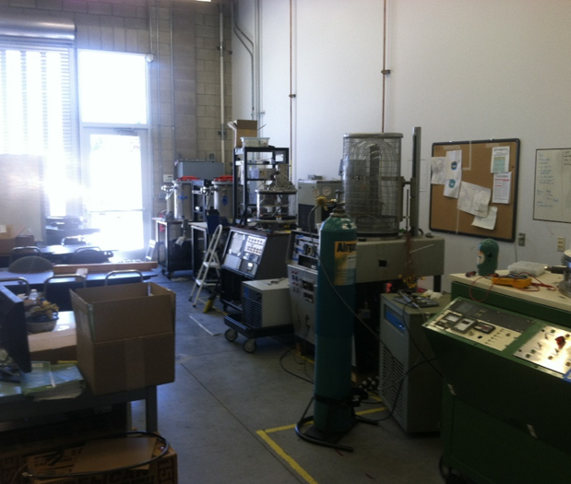
Astronautics curriculum
Fully implemented in 2013
Includes all topics required by ABET for an accredited BS program in Astronautics:
Spacecraft Attitude Determination and Control
Orbital Mechanics
Space Structures
Rocket Propulsion
Telecommunications
Space Environment
Power Systems (we added this one)
The Space Environments lab at Cal Poly, SLO

Slide 9
Systems engineering at cal poly

Slide 10
No dedicated class
Concepts are introduced as needed throughout the curriculum
Freshman Year
Intro to Aerospace Engineering
Engineering Requirements
Sophomore Year
Intro to Aerospace Design
Verification and Validation of Requirements
Junior Year
Subsystem specific design strategies
Senior Year
Full system design, functional teams
Intro to Aero
Intro to Design
Subsystem Design
System Design
Systems engineering principles throughout the curriculum

Slide 11
Plans and updates
Systems Engineering
Specific Actions
Sophomore course in system integration
Further refinement and restructuring of discipline specific design strategies
Elective class in modeling and simulation
As we continue to update the curriculum, we are seeking to formalize the systems engineering thread. We want to map learning outcomes associated with systems engineering to all courses offered in both concentrations with a culmination in Senior Design

Slide 12
The horizon simulation framework
Software built for system-level requirements verification through simulation

Slide 13
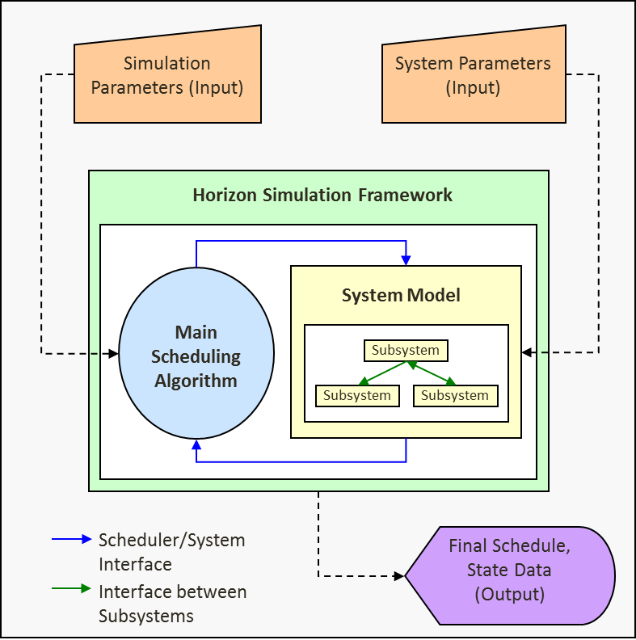
What is HSF?
A library of integrated software tools supporting rapid system-of-systems modeling, simulation and utility analysis
Provides an extensible and well-defined modeling capability concurrent with a scheduling engine to generate operational schedules of Systems-of-Systems with corresponding state data
Modular, Flexible with built-in utilities

Slide 14
Fundamental Scheduling Elements
Four fundamental scheduling elements
Task – The “objective” of each simulation time step. It consists of a target (location), and performance characteristics such as the number of times it is allowed to be done during the simulation, and the type of action required in performing that task.
State – The state vector storage mechanism of the simulation. The state contains all the information about system state over time and contains a link to its chronological predecessor.
Event – The basic scheduling element, which consists of a task that is to be performed, the state that data is saved to when performing the task, and information on when the event begins and ends.
Schedule – Contains an initial state, and the list of subsequent events. The primary output of the framework is a list of final schedules that are possible given the system.

Slide 15
The Main Algorithm
Contains the interface between the main scheduling module and the main system simulation module
Guides the scheduling algorithm in discrete time steps and keeps track of the results
Simulation Parameters (Input)
Main Scheduling Algorithm

Slide 16
Selectable Main Scheduling Algorithm
BDESA – Big Dumb Exhaustive Search Algorithm
Baseline scheduling algorithm
Provides a recursive scheduling algorithm which allocates constrained resources with respect to a cost function
Hybrid Genetic Algorithm
Recently added to the HSF
Provides improved performance over the BDESA in most cases

Slide 17
Fundamental Modeling Elements
Constraint – A restriction placed on values within the state, and the list of subsystems that must execute prior to the Boolean evaluation of satisfaction of the constraint. Also the main functional system simulation block, in that in order to check if a task can be completed, the scheduler checks that each constraint is satisfied, indirectly checking the subsystems.
Subsystem – The basic simulation element of the framework. A subsystem is a simulation element that creates state data and affects either directly or indirectly the ability to perform tasks.
Dependency – The limited interface allowed between subsystems. In order to keep modularity, subsystems are only allowed to interact with each other through given interfaces. The dependencies specify what data is passed through, and how it is organized. Dependencies collect similar data types from the passing subsystems, convert them to a data type the receiving subsystem is interested in, and then provide access to that data.
System – A collection of subsystems, constraints, and dependencies that define the thing or things to be simulated, and the environment in which they operate.

Slide 18
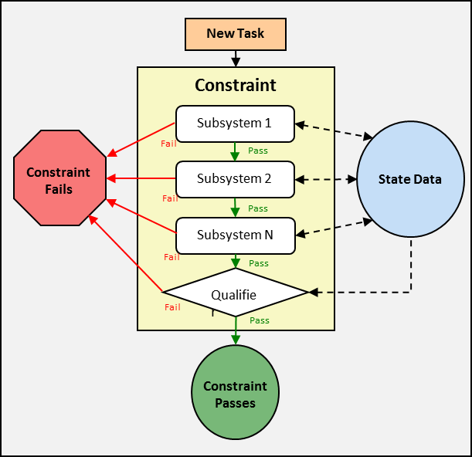
Constraint-Checking Cascade
Primary algorithm to check whether a system can perform a task
Internal constraint process:
Subsystems which contribute state data to Qualifier are evaluated
Qualifier evaluates validity of state
Constraint fails if a subsystem or the qualifier fails
Notes:
The primary algorithm invoked when determining whether a system can perform a task is the constraint-checking cascade. The internal functionality of a constraint is described, and then the context in which each constraint is checked. Last, the advantages of using the constraint-checking cascade are explained.
In order to confirm that the system and the schedule satisfy a constraint, first, the list of subsystems that provide data for the constraint are called. As each subsystem executes it adds its contribution to the state data. After all subsystems successfully execute, the constraint qualifier (the actually check on the validity of the state after the data has been added) is evaluated. Figure 5 shows a graphical representation of this internal constraint functionality.
If the qualifier is satisfied, then the next constraint repeats this process, until all constraints on the system have been checked. In this way, state data is generated indirectly involving only the subsystems necessary to check each constraint. Only after checking all the constraints does the scheduler run the subsystems whose data is not constrained. Figure 6 shows this constraint-checking cascade further.

Slide 19
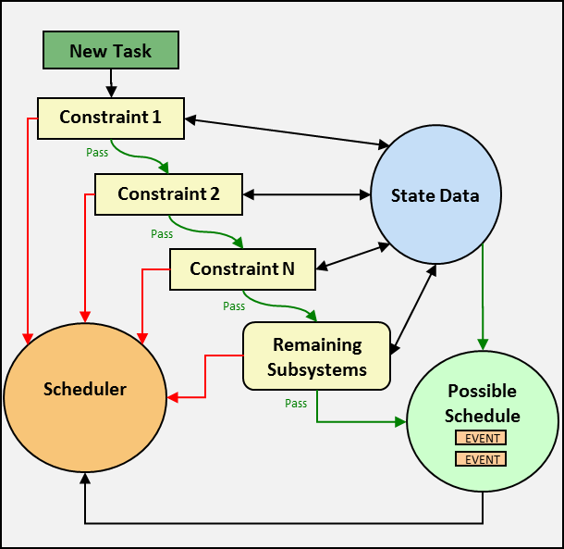
Constraint-Checking Cascade
Constraint-Checking Cascade:
Constraints are checked in user-specified order
Remaining subsystems evaluated
If any of the checks fail, no event is added to the schedule and the state is discarded
If all of the checks succeed, the task and state are added to the schedule as a new event
“Fail-fast” constraint methodology
Notes:
This procedure has two distinct advantages over simulating the subsystems in a fixed precedence order. First, constraints whose qualifiers often fail can be prioritized at the beginning of the cascade to create a “fail-first system.” This ensures that if the system is going to fail a possible task, it happens as close to the beginning of computation as possible, and does not waste simulation time. This is especially useful if the hierarchy of subsystem execution has many branches that are independent of each other. Additionally, it caters to the Systems Engineering user, in that it primarily drives the simulation on CONOPS-derived constraints.

Slide 20
Subsystems
Subsystems are state transition objects
Describe how the subsystem goes from its old state to new state in performing the task
Inputs
Old state of the Subsystem
Task to be performed
Environment to perform it in
Position of their asset
CanPerform() is the main execution method
Code describes the governing equations of the subsystem
Output
New State of the Subsystem
Notes:
Subsystems are primarily state transition objects. As inputs they take the past state history, the new state to save values to, the task to be performed, the environment in which they perform that task, their specific parameters (if any), and the position of the asset they reside in. A subsystem is free to use as little or much of this information in setting values identifying their performance of the task to a new state. They return a Boolean value that states whether or not the physical constraints and checks that are within the subsystem’s canPerform() function can successfully complete the task as they see it. In this way the subsystems are really the basic functional “workhorses” of the system. They create state data as they transition from an initial state to a final target state while completing a task.

Slide 21
Dependencies
Dependencies are the interpreters between subsystems
Example: Power subsystem dependent on ADCS subsystem for power input of solar panels due to solar panel incidence angle to sun vector
ADCS only interested in orientation within Environment
Power only interested in how much power other subsystems generate or consume
The dependency function would translate the orientation of the spacecraft into how much power the solar panels generate
Dependencies structured as they are to avoid “subsystem creep”
Information about and functions from each subsystem do not migrate into the other subsystems
Notes:
If subsystems are the basic functional blocks that make up the system, then dependencies are the arrows that connect them together. This analogy is useful, because it reinforces the idea of subsystems as independently executing blocks of code. Previous simulation frameworks have fallen prey to what is known as “subsystem creep”; where information about and functions from each subsystem slowly migrate into the other subsystems. This is an evolutionary dead-end in simulation frameworks, as it makes diagnosis of problems difficult and reuse of the subsystem libraries impossible. Additionally it goes against the tenets of object-oriented programming in that any given subsystem class should only have information contained within that subsystem, and access to data types that the subsystem would understand how to deal with.
Dependencies are then the interpreters between subsystems. They have access to each of the subsystems and understand how to translate data generated by one subsystem into data needed by another subsystem. For example, one dependency might convert spacecraft orientation information generated by the attitude dynamics and control system (ADCS) subsystem into an incidence angle between the solar panel face and the sun vector for the power subsystem. The power subsystem has no business knowing what a quaternion is, or how the spacecraft is oriented. It is only interested in how much power the solar panels are receiving. Likewise, the ADCS subsystem has no business of knowing how much power the solar panels are generating because of its orientation maneuvers. In this way, subsystems process only data that they know how to handle and are logically contained within their domain.

Slide 22
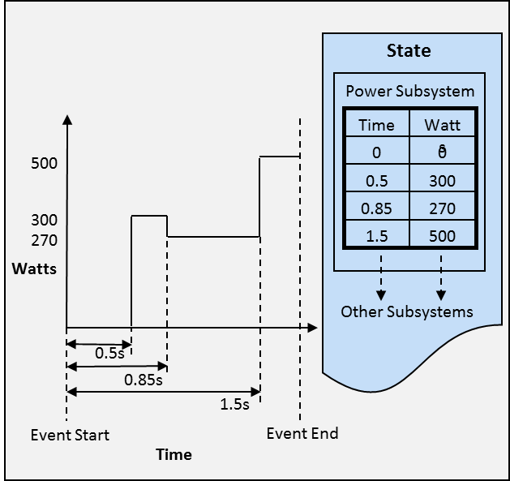
The System State
State is unique to each event
All the data generated over the course of the event is stored in its corresponding state
Storage like a bulletin board
Only changes from previously recorded values are posted
Most recent saved value of the variable is also the current value
Notes:
As the subsystems determine that they are able to perform a task, variables that describe the operation of the system must be saved somewhere. In the Horizon framework, this repository of data is called the state. Each state is unique to each event, such that all the data generated over the course of the event is stored in its corresponding state. Each state also has a pointer to the previous state to track previous changes and simplify in the identification of initial conditions for simulation algorithms. Storage inside the state emulates the mechanics of a bulletin board. When new data is generated, only changes from previously recorded values are posted, with the new time that they occur. This way, when reading from the state, the most recent saved value of the variable is also the current value. Many different objects in the framework have access to the state, including subsystems, constraints, dependencies, data output classes and schedule evaluation functions. Figure 7 illustrates an example of how the state is used to keep track of data.

Slide 23
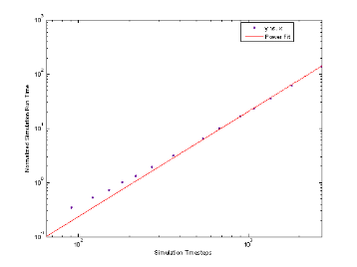
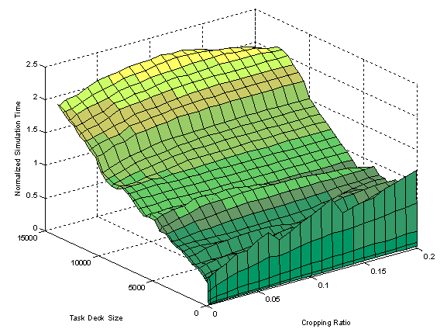
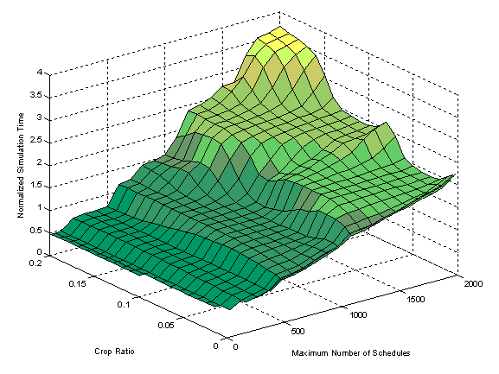
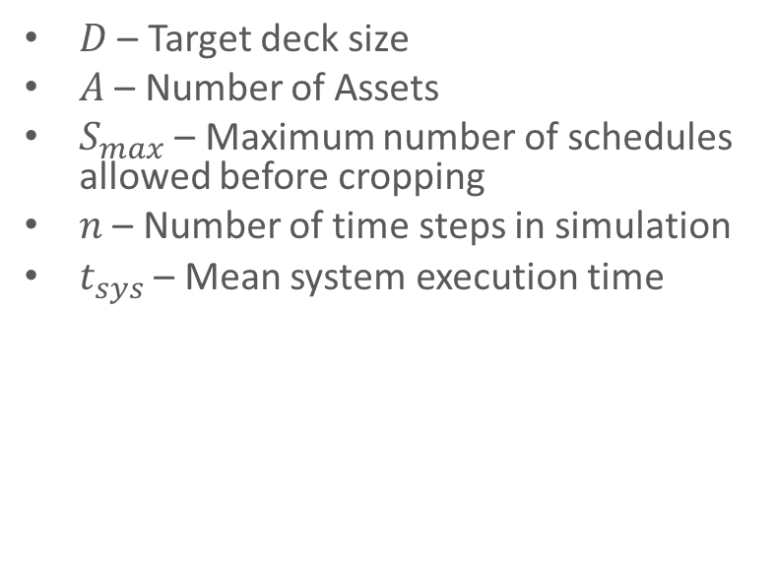
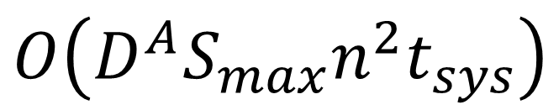
BDESA Parametric Runtime Analysis
$D$ – Target deck size
$A$ – Number of Assets
$S_{max}$ – Maximum number of schedules allowed before cropping
$n$ – Number of time steps in simulation
$t_{sys}$ – Mean system execution time
$$O\left(D^{A}S_{max}n^{2}t_{sys}\right)$$

Slide 24
Subsystem Definition
Subsystems are encapsulated by SubsystemNodes
SubsystemNodes solve the problem of subsystems having no hierarchical information
SubsystemNodes point to the SubsystemNodes they are dependent on, as well as the Subsystem they represent
Multiple SubsystemNodes can point to the same Subsystem
SubsystemNode 1
SubsystemNode 2
SubsystemNode 4
SubsystemNode 5
SubsystemNode 6
SubsystemNode 3
SubsystemNode 7
SubsystemNode 8
SubsystemNode 9
SubsystemNode 10
SubsystemNode 11
Subsystem of interest
SubsystemNode 12
Notes:
When facing the problem of organizing subsystems together into assets, providing a concise and accurate execution order with dependencies, and ensuring that the Framework remained true to the three initial tenets of the design, research was done into existing applications of hierarchical networks. A very close match was found with the online C++ library object boost::adjacency_list. The adjacency list describes a unidirectional network flow of objects. Within each object is a vector of links to its chronological predecessors. In this way, there are only two states of an object, independent of other objects of that type, or dependent on other objects. By picking any node in the network of interest, one can find all predecessors necessary for exactly identifying the node simply by traversing the predecessor list for each node.
Using this network structure and recursion in calling subsystems to perform, subsystems automatically confirm that their predecessors had previously executed, and that any data that they might need had already been set to the state. This is shown in Figure 16, above.
Having SubsystemNodes as the actual hierarchical implementation of subsystems affords additional benefits. That is that multiple SubsystemNodes can point to the same subsystem, since subsystems are just state-transition functions that input an old state, and describe how the task is accomplished by saving data on the subsystem’s operation to a new state. This helps the “plug-and-play subsystem library” concept, in that only one “reference” subsystem is needed to describe the governing equations for that type of subsystem, and the SubsystemNodes are the individual instantiations of that subsystem in multiple places.
SubsystemNodes also store additional data: whether or not they have executed previously. Going back to Figure 16, consider later in the system simulation that Subsystem 12 is required to execute this time step. When it recurses to Subsystem 10, instead of recursing all the way back up the tree, it finds that Subsystem 10 has already executed, confirmed that it can perform the task, and added its data to the state. Now, Subsystem 12 can skip the whole section of the tree and avoid repeating the same calculations. There is no call to any Subsystem that will recalculate Subsystem data already calculated, or avoid running a Subsystem that is required.
The one constraint that this network type requires is that there are no circular dependencies. A subsystem can never be able to recurse all the way back to itself. However, this is already a requirement for dependencies and their interactions with subsystems, so the adjacency lists work perfectly. This improvement also pared down the number of subsystems required in any constraint. Previously constraints would have to be loaded with not only the subsystem that would set the data it was to evaluate, but also every subsystem that had to execute previously in the hierarchy in the order for them best to execute.
Adjacency list hierarchies like those from the Boost library specify chronological predecessors
Version 2.0 implements this network structure to confirm that previous subsystems have already run

Slide 25
Asset Definition
In order to Task multiple assets, Asset objects were created
Assets defined as: Any actor that had subsystems as members and knowable motion
SubsystemNode 1
SubsystemNode 2
SubsystemNode 4
SubsystemNode 5
SubsystemNode 6
SubsystemNode 3
SubsystemNode 7
Asset 2
SubsystemNode 8
SubsystemNode 9
Asset 1
SubsystemNode 10
SubsystemNode 11
Asset 3
SubsystemNode 12
Notes:
With the need to make assets a physical entity in the Horizon framework, an asset object had to be created. These were defined as anything that had subsystems and a known position. It is specifically for the user to decide whether these are task-able, or rather just autonomous and self-sufficient entities. At the current time, Version 2.0 does not yet support assets that cannot be tasked, but in the near future, this may be possible. Functionally, subsystemNodes point to their asset, rather than the asset containing the subsystemNodes. This is because when seen procedurally from the function calls that subsystemNode would need to make, and the constraint-based subsystem checking methodology used, a position, and involvement in an asset is really an attribute of a subsystemNode instead of the other way around. This may be at odds with the way an asset is designed (requirements flowing down), but the interfaces with which assets and subsystemNodes are created make the architecture seem more intuitive. A sample system with 3 assets and 12 subsystems is shown below in Figure 17.
It is worth nothing that not only do subsystemNodes have dependencies on each other, but this diagram implies that assets also have dependencies. It could be the case that subsystemNodes within assets are dependent back and forth between the assets in multiple places. This should be carefully monitored as it may lead to situations where tasks are only added to all assets at once. Under specific situations this may be what is desired, which is why this functionality remains in the Horizon Framework.
Functionally, an asset is an attribute of a subsystemNode due to the fact that it just specifies involvement in a Task and a Position
Assets can have dependencies on one another by having involved subsystemNodes have dependencies to one another

Slide 26
System and Asset Schedules
Multiple assets requires the ability to task each asset independently
Each asset must then have its own schedule (which is called an AssetSchedule)
AssetSchedules hold a list of events and an initial state
The whole system must have a unique schedule (called a SystemSchedule)
SystemSchedules hold a list of AssetSchedules
assetSchedule 1
Initial State
Event
Event
Event
Event
systemSchedule
assetSchedule n
Initial State
Event
Event
Simulation Time
Notes:
In Version 1.2, a schedule was a series of events where the system performed a task. However, with multiple assets comes the need to perform multiple tasks at any one time. This means that schedules must be unique for each asset. As such, a schedule became a systemSchedule, which contained any number of assetSchedules. A systemSchedule details what the entire system does throughout the simulated time period. SystemSchedules also hold many accessor functions like finding the number of times a task has been performed or finding its own value. For each asset in the system, the systemSchedule contains one assetSchedule, which is linked to an asset, and holds both an initial state and a vector of events. Each subsystemNode knows which asset it belongs to, thus which assetSchedule it is involved in, and can find the task in which its asset is currently involved. Thus, the limited interaction between the hierarchy of the system and the scheduler is preserved. A graphical illustration of the systemSchedule object is included below in Figure 18 in the interest of clarity.
CanExtend() and scheduling no event
In Version 2.0 it does not make sense to require that each asset be able to perform the same task or that each asset must perform a task at all
Instead, at each simulation time step in order to create a new systemSchedule at least one of the assets must be able to start a new task
All the combinations of assets performing each of the tasks are created for each old schedule
One serious implication - Assets that are not scheduled must extend their previous events further in a “cruise mode”
Called the canExtend() function
Simply checks that given nominal operation of a system in its current environment, can it continue to pass the system’s constraints and the subsystems requirements
Changes to the State
Previously, retrieving incorrect data was possible given a relatively common user error
Something type-safe needed at compile-time to let user know they are asking for the wrong data type
State now contains vectors of maps of Profiles of different types
Profile is a templated class
All access to the State is done by setting and retrieving Profiles
2 main benefits
Profile has mathematical methods to do extremely common tasks, reducing modeling time significantly (50-90% from tests)
Profiles and StateVarKey (the key used to store and retrieve values) are both templated
Specifying a Profile return type when looking up a variable that is incompatible with the StateVarKey type causes a compiler error

Slide 27
HSF Version history
1.0 – Initial Release
1.1 – Math Libraries Added
1.2 – State Profile Added
2.0 – Multi-Asset Capability
2.1 – Auto Circular Dependency Check
2.2 – LUA Scripting
2.3 – Multi-core and Networking Support

Slide 28
The Aeolus Constellation
The Horizon Framework Multi-Asset Baseline Test Case

Slide 29
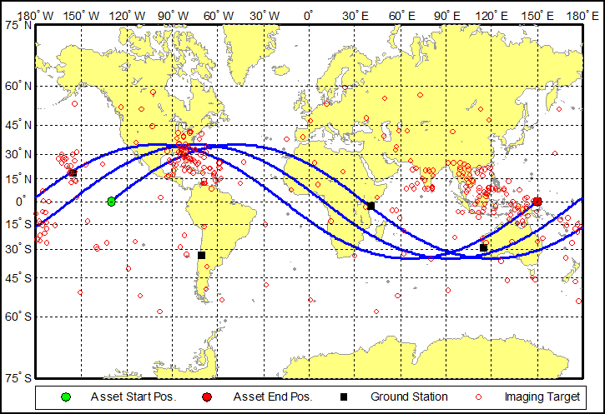
Aeolus Mission Concept
Aeolus: The Greek god of wind
Extreme-weather imaging satellite
Circular, 1000km, 35 degree inclined orbit
Simulation date: August 1st 2008 for 3 revolutions
Targets clustered into high-risk areas, including Southeast Asia and the Gulf of Mexico
Sensor has ability to generate data while in eclipse
A day-in-the-life of the Aeolus constellation
Notes:
The capstone software requirements test necessitated a low-fidelity system simulation performing a reasonably well understood aerospace application. An end-to-end use case of the software comprehensively testing the input-output framework capabilities with which the analyst would directly interact is described. Included are descriptions of the subsystem models and constraints imposed on the system, as well as visualizations of the orbits, targets, and results. The results are then discussed within the context of whether or not they constitute valid and useful simulation results.
It was decided that the system would be an extreme-weather imaging satellite for several reasons. It afforded the possibility to use large decks of targets, spread out geographically in order to let the scheduler choose between a subset of possible targets each time step. It also made the output of possible schedules with big decks of state data easy to evaluate and analyze. Lastly, targets could be valued for importance, time-criticality and minimum image quality to exercise the value function evaluations.
The simulation was named Aeolus for the Greek god of wind. Targets were clustered into high-risk areas, including Southeast Asia and the Gulf of Mexico. Additional targets were scattered randomly around the globe as incidental weather anomalies. Additionally, it was assumed that the sensor could generate useful images, even when in eclipse to further stress the system.
It was envisioned that users would submit weather phenomenon to a ground station for approval. Those weather phenomena were judged and a full list of approved targets would be created with values on each one as the operators saw fit. Next, a full simulation of the Horizon framework would be run with the given target deck and the initial conditions of the satellite for a certain time period. Results would be used for mission analysis and command generation to decide which targets would be captured by the actual satellite.
Aeolus CONOPS
Subsystems
Access – Generates access windows for different types of tasks
Attitude Dynamics and Control System – Orients spacecraft for imaging
Electro-Optical Sensor – Captures and compresses images when it has access to an imaging target and sends data to the Solid-State Data Recorder
Solid-State Data Recorder – Keeps imagery data before being sent down to a ground station
Communications System – Transmits imagery data when it has access to a ground station
Power – Collects power usage information from the other subsystems, calculates solar panel power generation and depth of discharge of the batteries
Constraints
During imaging, no information can be sent to ground stations
The data recorder cannot store more than 70% of its capacity
The depth of discharge of the batteries cannot be more than 25%

Slide 30
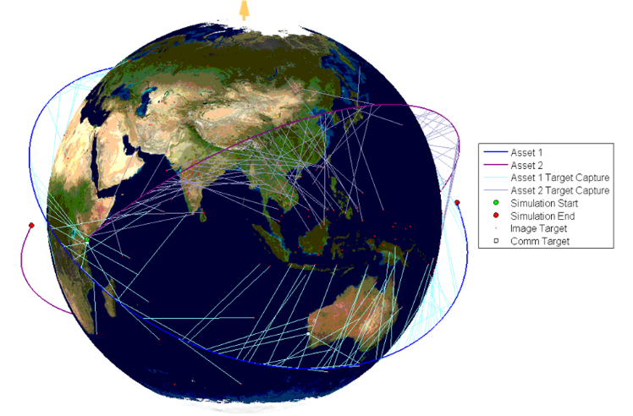
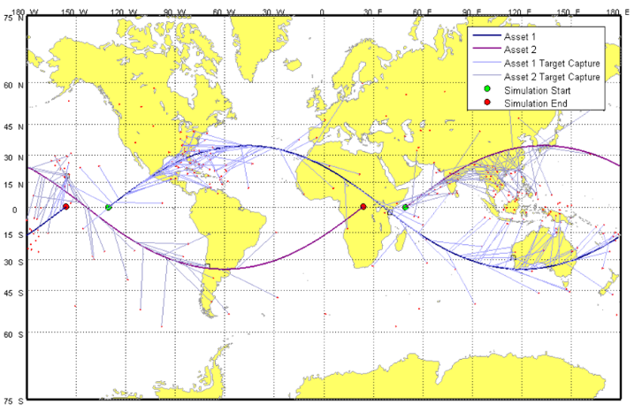
The Aeolus Constellation: Results
Matlab visualization of HSF simulation results
Notes:
Aeolus Constellation CONOPS
Two assets were created, and the constituent subsystemNodes were duplicated from the same subsystems found in the previous test case
Constraints and dependencies were changed to use the accessors from the new profile class
At heart, the system that was modeled is identical, albeit with the number of assets doubled
The first asset kept the original asset’s orbit
The second asset was initialized using the same orbital parameters except the RAAN was rotated 180 degrees
Assets get better ground track coverage of targets in one revolution

Slide 31
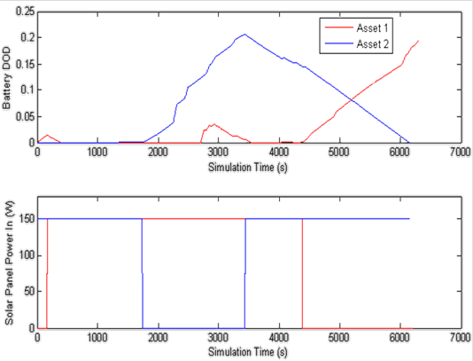
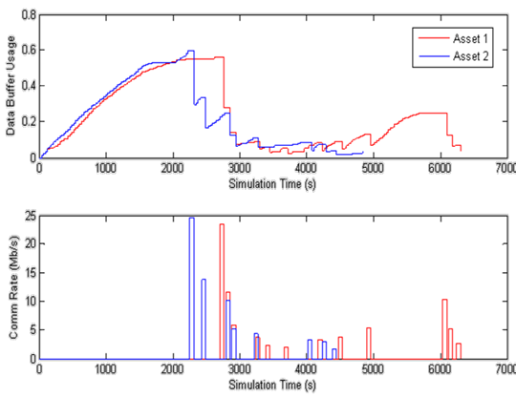
The Aeolus Constellation: Results
Typical day-in-the-life state data

Slide 32
Future Plans
Drag-and-Drop Simulation Creation GUI
PICASSO – Version 1.2 Released
Automatic “Sanity-Checking” for User-Specified Code
System Model Failure Recording
Understanding why can’t a subsystem respond to a request will help the analyst reconfigure the system or requirements
Module Library Creation (Open Source?)
Underway
Notes:
Dependency Integration into SubsystemNode
Currently, dependencies are static functions that are called on a case-by-case basis by the subsystems that require them. Since they are globally scoped, this means there is little flexibility within them, and the user has the possibility of calling the wrong one inside a subsystem. They do not have hierarchical network information and are incapable of determining which the correct state to use is, so at the current time dependencies cannot exist between assets. The solution to this is to embed dependencies inside subsystemNodes somehow. Since subsystemNodes know their network position and know which subsystemNodes they are dependent on, they naturally could call specific dependency functions by pointer and directly give their corresponding subsystem the correct data.
Drag-and-Drop Simulation Creation GUI
As stated previously in Part B, a GUI is being created that will allow users to drag-and-drop system blocks into a “sandbox” type window where they can arrange the layout of the system in a visual way. This will also aid in ease of use as it will pre-generate templates for everything and leave only the specific function coding for the user.
Automatic “Sanity-Checking” for User-Inputted Code
With the implementation of a GUI, values and code that is inputted can go through a sanity-check before the C++ code is built. This would involve looking at orbits, task-types, subsystems getting and setting state variables and a myriad of other interactions that are constrained on both ends and making sure that the user has entered things, which correspond to a valid action given the Horizon Framework. Since the C++ programming language is virtually unconstrained, many things that could be compiled in code simply are not supported. This would check common errors and display warnings to the user (which could be suppressed if desired).
Parallelization
When the scheduler is generating possible schedules, a large list of fully formed, yet un-simulated systemSchedules is generated. These exist in independent universes and are able to be calculated without information from any other systemSchedule. In parallel processing terms, this is referred to as an “embarrassingly parallel” problem. It means that splitting these tasks to compute on different processor cores, or even on entirely different machines is relatively simple. In situations were a large number of assets are to be attempting to schedule a large number of tasks, combination generation shows that there are going to be a huge possibility of different things to do at each time step. Thus, parallelization of the simulation of each systemSchedule may be necessary.
LHLV Coordinate System Support
Currently the Position objects only support ECI and LLA coordinate frames. LHLV is useful when determining equations of motion or line of sight from objects close to the surface of the earth. When modeling things like aircraft and near-space assets, the user would greatly benefit from adding a built-in LHLV coordinate system, which could automatically be used and would be invisible to the user.
Matrix Templatization
Currently doing a large number of matrix operations in a row can propagate numerical errors, even using numbers as precise as double-precision values. This was experienced when doing vector math on radically different sized vectors; such as the vectors from earth to the sun and from the earth to a space asset. Templatizing the matrix class would allow it to have as much or as little precision as necessary, so other means would not have to be used to ensure numerical stability.
Error Recording
When simulating a model for the first time, it is very likely that it does not perform as expected. First output schedules have had all kinds of peculiarities including not having any events, going over the simulation end time, not down linking, imaging comm. stations, only down linking among others. The Framework would benefit from a record of why schedules failed when they were trying to be created. This would aid the designer in finding what was constraining the scheduler from adding events to each of the schedules. Additionally, this could help while designing the system to find bottlenecks or leverage points imposed by subsystem design parameters or CONOPS requirements.
Module Library Creation
As previously discussed, the Horizon Framework would greatly benefit from having a large library of modules created that have been tested. A library of subsystems, constraints, dependencies, and whole assets that have been simulated in multiple environments would help new users understand the functionality of each of these objects and the software requirements for writing a new one. It would also allow rapid prototyping of systems by varying parameters on well-known and well-behaved subsystems.

Slide 33
Questions for Boeing

Slide 34
Discussion and thoughts on:
Model Based Systems Engineering (MBSE)
System Modeling Language (sysML)
Current needs from academia (or Cal Poly)
Any projects you can share?
What topic(s) are fundamental for systems engineers you hire?
What topics would be appropriate for a specialized class in modeling and simulation?
Moving forward – opportunities for collaboration?

